Slide 1

Inventory Management System
Software Demonstration

Slide 2
Key Features
Graphical User Interface (GUI)
Inventory Tracking
Database Integration
Technologies Used (Java, JavaFX, JDBC)

Slide 3
Technologies Used
Java
JavaFX
GitHub
IntelliJ
MySQL

Slide 4
User Experience
User Friendly Interface
Ease of Navigation

Slide 5
Additional Features
Add
Search
Delete
Update

Slide 6
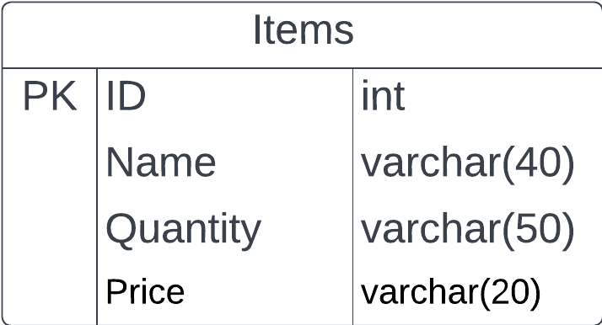


Database Integration
Database Used (MySQL)
Data Storage
Data Retrieval

Slide 7
Data Structure Used
Binary Search Tree
Hash Table
Set, Map
Queue
Linked List

Slide 8
Future Improvements
Add Supplier and Providers
Improve with Multi-threading

Slide 9


Thanks😊

